Slide 1
Economic impact assessment in sub-saharan Africa
Animal-Human Transmission Dynamics of Taenia solium
Kayla Lanker
Kathleen Moriarty
Arunima Bhattacharjee
9th June 2021

Slide 2
Outline
Background of Taenia solium
Burkina Faso
EpiCyst Model
Economics of Interventions
Cost Effectiveness Analysis
Sensitivity Analysis
Limitations
Conclusion

Slide 3
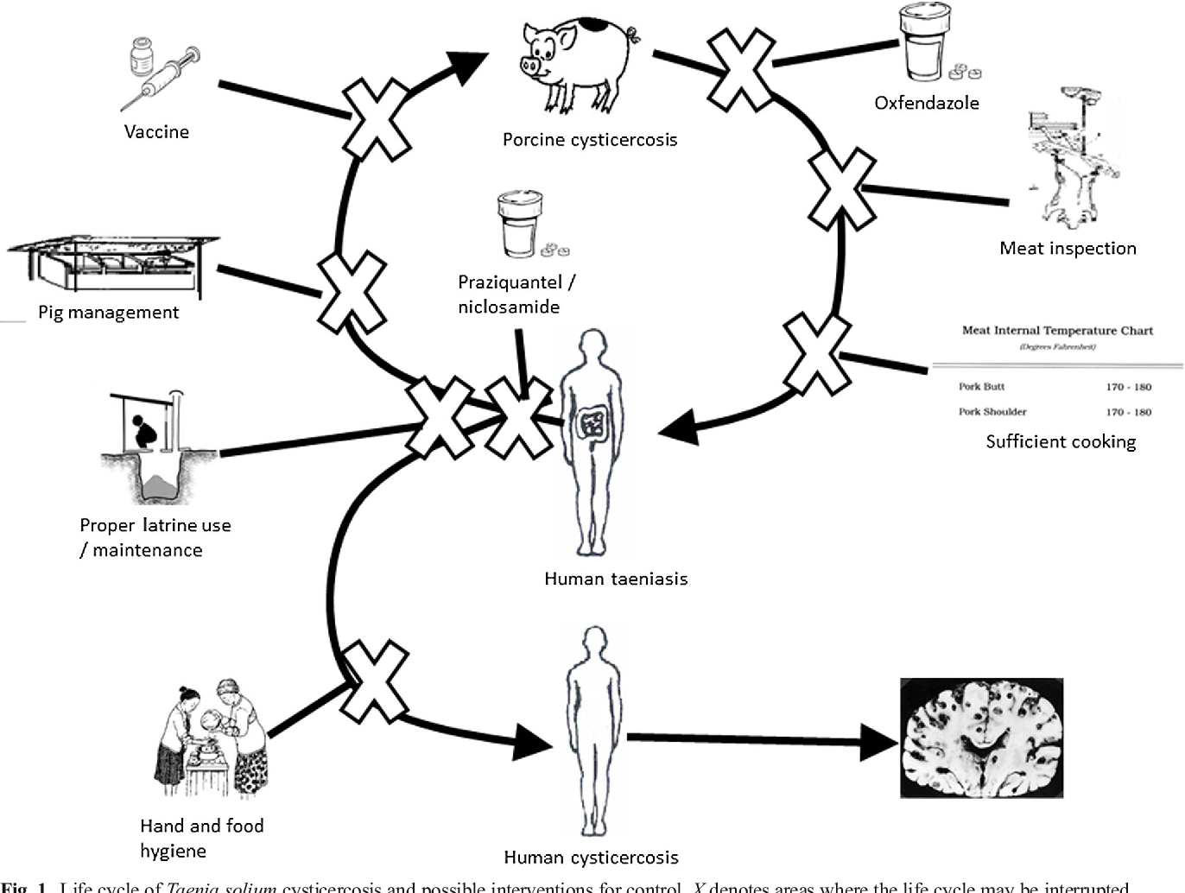
Life Cycle of T. solium
Human Taeniasis
Human Cysticercosis
Neurocysticercosis (60-90%)
Epilepsy
Chronic headache
Porcine Cysticercosis
do not live long enough to feel effect...
Carabin and Traore, 2014
Notes:
The lifecycle indicates, at each stage, key research gaps and data needs important for epidemiological modelling.
https://www.ncbi.nlm.nih.gov/pmc/articles/PMC6476523/

Slide 4
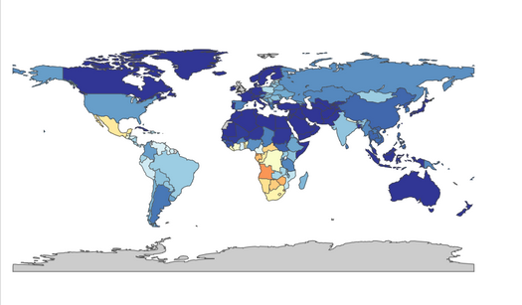
Neurocysticercosis and Epilepsy
Source: IHME
Neurocysticercosis with epilepsy (2015)
Notes:
Taenia solium neurocysticercosis is a common cause of epileptic seizures and other neurological morbidity in most developing countries. It is also an increasingly common diagnosis in industrialized countries because of immigration from areas where it is endemic. 30% of all epilepsy cases are caused due to NCC in countries where the parasite is endemic. NCC and epilepsy can be associated up to 70%, particularly in poor and ignorant people.
https://vizhub.healthdata.org/gbd-compare/

Slide 5
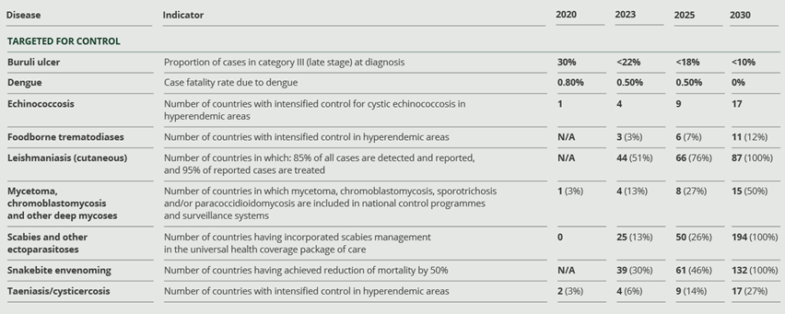
WHO NTD Road Plan 2021 - 2030
Notes:
WHO for developing a validated strategy for the control and elimination of T. solium taeniasis/cysticercosis; To control and to eliminate a disease is multidisciplinary and multi-sectoral work. To make a sustainable elimination broader inclusive planning to be done to work together with multiple stakeholders and partners with. CystiTeam working on improving the cystiSim and EPICYST models collaboratively. Knowledge gaps have been highlighted to further model development, including age-specific infection trends and local practices to inform setting-specific parameterization. https://www.who.int/bulletin/volumes/98/3/19-238485.pdf

Slide 6
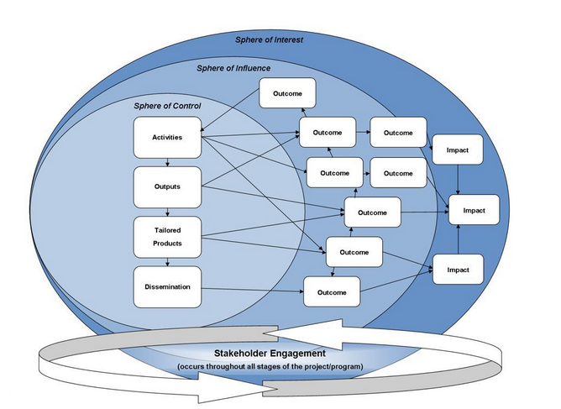
Why a One Health Approach?
Impact I: Control Taeniasis/Neurocysticercosis
Problems (Neurocysticercosis)
Human and animal interaction (Human & Pigs)
Activity groups
Lead Partners
Public & private sector
Outcome
Economics
Impact
Impact II: Elimination Taeniasis/Neurocysticercosis
Impact III: Sustainable elimination Taeniasis/Neurocysticercosis
Impact IV: Overall better healthcare
Source: Future learn
Theory of Change Model

Slide 7
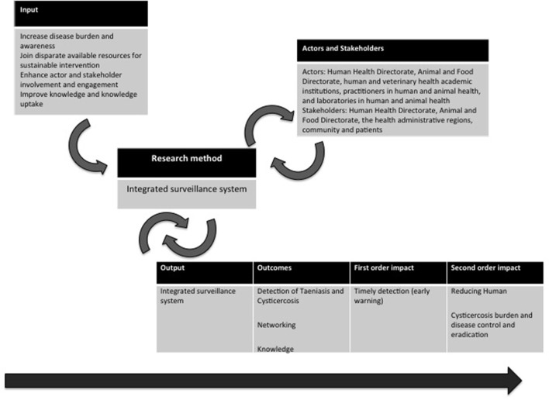
Theory of change applied to the Observatory of Taeniasis and Cysticercosis in Portugal.
Source: Front Public Health. 2018
Notes:
https://www.ncbi.nlm.nih.gov/pmc/articles/PMC5859019/

Slide 8
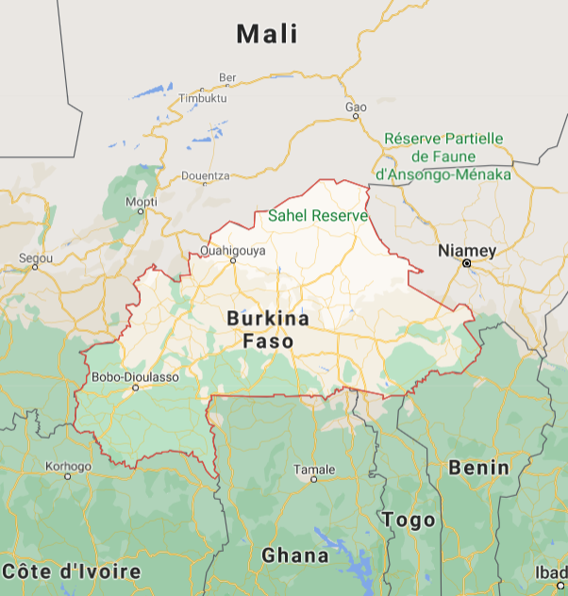
Burkina Faso
Human Development Index (HDI) ranking 182 (HDI value 0.452) amongst 188 (2020)
40.1% of its population lives below the national poverty line
70% of population lives rurally
65% practice open defecation
8% of rural households have access to basic hygiene services
Economy depends on agriculture (40%) and livestock production (12%)
Pig population (around 2 M)
Tethered
Free roaming
Source: Google
Notes:
http://hdr.undp.org/en/statistics/

Slide 9
Baseline Parameters for Burkina Faso
Name | Parameter | Value | Source | Country
Pig population | PPS | 2,587,862 | Knoema, 2021 | Burkina Faso
Human population | HPS | 20,321,378 | Data Commons, 2019 | Burkina Faso
Human taeniasis prevalence | HTPrev | 0.028 | Skirp et al, 2021 | Burkina Faso
Human cysticercosis prevalence | HCPrev | 0.0473 | Skirp et al, 2021 | Burkina Faso
Estimated human NCC epilepsy prevalence | HNCPrev | 0.01848 | Millogo et al, 2012 | Burkina Faso
Porcine cysticercosis prevalence | PCPrev | 0.1887 | Skirp et al, 2021 | Burkina Faso
Human average life expectancy [years] | LEH | 61 | Data Commons 2019 | Burkina Faso
Pig average life expectancy [years] | LEP | 1.88 | Skirp et al, 2021 | Burkina Faso

Slide 10
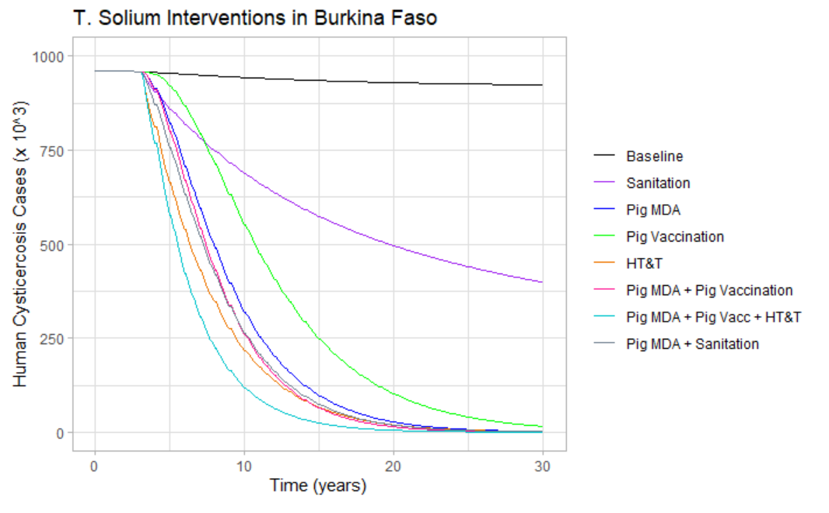
Epicyst model output
Notes:
Chemotherapeutic intervention targeted at humans or pigs had a big impact, 94% and 74% of cysticercosis cases averted. Improved sanitation , meat inspection and animal husbandry are less effective but are still able to reduce prevalence singly or in combination.
Epicyst model output https://parasitesandvectors.biomedcentral.com/articles/10.1186/s13071-017-1988-9

Slide 11
Direct and Indirect annual costs of T. solium infection in Humans
Name | Country
 | Mozambique | Tanzania | South Africa | Mexico | West Cameroon | Burkina Faso
Human population of study | 330,328 | 44,928,923 | 7,088,000 | 125,235,587 | 5,065,382 | 20,321,378
Human NCC prevalence | 0.0070 | 0.0011 | 0.0053 | 0.0025 | 0.0099 | 0.0185
Human NCC cases | 2151 | 17853 | 34662 | 307583 | 50326 | 375539
Direct human losses (US$) | $9,626 | $745,711 | $15,100,000 | $54,929,000 | $1,552,644 | $9,886,270*
% of total | 0.10 | 0.09 | 0.75 | 0.30 | 0.10 | 0.10*
Indirect human losses (US$) | $61,462 | $3,903,082 | - | $111,720,000 | $12,611,425 | $80,301,689*
% of total | 0.66 | 0.49 | - | 0.60 | 0.85 | 0.85*
Pig related losses (US$) | $22,282 | $3,284,301 | $5,000,000 | $19,551,000 | $698,543 | $4,447,885*
% of total | 0.24 | 0.41 | 0.25 | 0.11 | 0.05 | 0.05*
Total losses (US$) | $93,370 | $7,933,094 | $20,100,000 | $186,200,000 | $14,862,612 | $94,635,844*
Price per NCC case (US$) | $33 | $106 | $436 | $542 | $252 | $214**
Approx DALYs/1000 person-years | 6 | 1 | - | - | 9 | 9*
Source | Trevisan et al 2018 | Trevisan et al 2017 | Carabin et al 2006 | Bhattarai et al, 2019 | Praet et al, 2009 | Millogo et al, 2012
Type of study | District level primary data | Systematic review | Review and primary data | Review and primary data | Review | Calculations, Assumptions
* has been estimated/assumed based on the other countries’ statistics ** does not include direct and porcine costs

Slide 12
Indirect annual costs of T. solium infection in Pigs
Name | Country
Country | Mozambique | Tanzania | South Africa | Mexico | West Cameroon | Burkina Faso
Pig population of study | 20,411 | 1,573,080 | 290,350 | 17,315,000 | 285,018 | 2,587,862
Estimated PCC prevalence | 0.13 | 0.117 | 0.0925 | 0.19 | 0.056 | 0.1887
Estimated PCC cases | 2595 | 184050 | 26857 | 3289850 | 15,961 | 488330
Pig related losses (US$) | $22,282 | $3,284,301 | $5,000,000 | $19,551,000 | $698,543 | $4,447,885*
% of total | 0.24 | 0.41 | 0.25 | 0.11 | 0.05 | 0.05*
Value of healthy adult pig | 55 | 90 | - | 96 | 145 | $100*
Value reduction of infected pig | 50% | 50% | 50 US$ | 25% | 30% | 30%*
Source | Trevisan et al 2018 | Trevisan et al 2017 | Carabin et al 2006 | Bhattarai et al, 2019 | Praet et al, 2009 | Skrip et al, 2021
Type of study | District level primary data | Systematic review | Review and primary data | Review and primary data | Review | Calculations, Assumptions
* has been estimated/assumed based on the other countries’ statistics

Slide 13
Status Quo
Status Quo: Estimated annual monetary cost of T. solium in Burkina Faso
Name | Value (US$) | Source | Country
Cost per case of human NCC | 214 | Praet et al, 2009 | Cameroon
Cost per PCC | 30 | Praet et al, 2009; Bhattarai et al, 2019; Trevisan et al 2015 | Cameroon, Mexico, Tanzania
% of pigs slaughtered / year | 0.6 | FAO, 2005 | Burkina Faso
Economic burden of human NCC | 80365360 | Calculated
Economic burden of PCC | 8789932 | Calculated
Total annual monetary burden | 89155292 | Calculated
Assumptions:
no human NCC cases are currently being treated
population and costs are homogenous

Slide 14
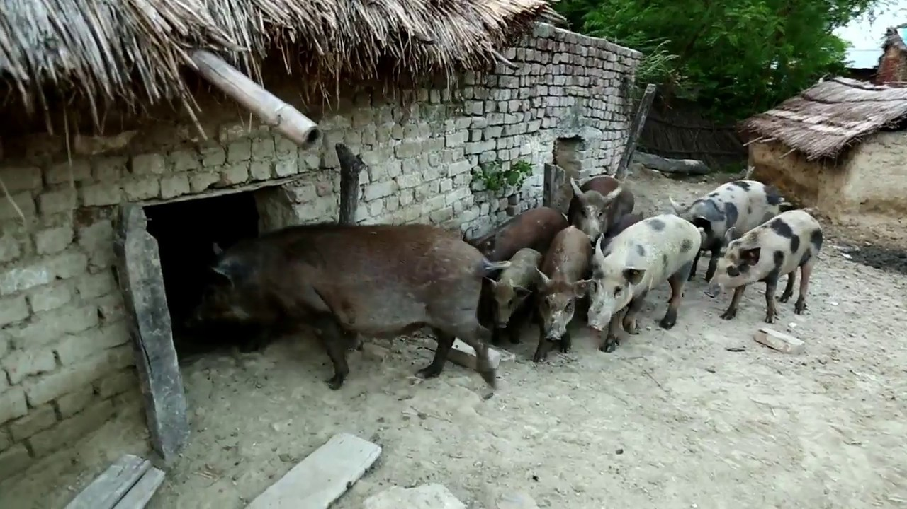
Pig MDA
MDA of pigs: Estimated annual monetary cost in Burkina Faso
Name | Value per dose (US$) | Source | Country
Cost of medication (Oxfendazole) | 0.5 | Geerts, 2016
Indirect costs of MDA (transport, education) | 0.05 | Tago et al 2017 | Senegal & Nigeria
% of pigs slaughtered / year | 0.6 | FAO 2005 | Burkina Faso
% of pigs cyst free | 90 | Pondja et al, 2012 | Mozambique
Total cost each year | 853,994 | Calculation
Assumptions:
Medication is given at correct time points
Effectiveness of medication is the same in all breeds of pigs in Burkina Faso
90% of pigs remain cyst free up until slaughter
WHO, 2020

Slide 15
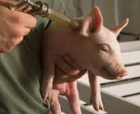
Pig Vaccination
Vaccination of pigs: Estimated annual monetary cost
Name | Value per dose (US$) | Source | Country
Cost of TSOL18 vaccine | 0.1 | Geerts, 2016
Indirect costs of vaccination campaign | 0.34 | Tago et al, 2017 | Senegal and Nigeria
Number of times required to vaccinate | 2 | Geerts, 2016
Initial number of pigs to vaccinate | 2,345,188 | Calculation
New pigs/year | 1,407,113 | Calculation
Total cost in first year | 2,063,765 | Calculation
Total cost after first year | 1,238,259 | Calculation
Assumptions:
Both doses of vaccine are given
Vaccines remain viable until given (proper storage)
Effectiveness of vaccine is the same in all breeds of pigs in Burkina Faso
https://www.nationalhogfarmer.com/animal-health/each-farm-needs-right-vaccination-program-pigs-and-profits

Slide 16
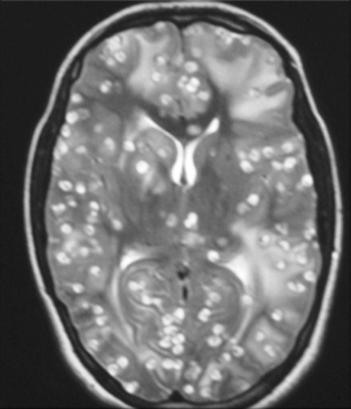
Human Test and Treat
Human test and treat (HT&T): Estimated annual monetary cost
Name | Value (US$) | Source | Country
Cost of Praziquantel (10mg/kg) single dose | 0.15 | WHO fact sheet
Cost of Albendazole (400 mg) 1 pill | 0.04 | Hall et al, 2009; WHO fact sheet
Cost of diagnostic (ELISA) | 2 | Proaño-Narvaez et al, 2002 | Mexico
Cost of visit to health clinic | 1.2 | Salari et al, 2020
Cost per taeniasis case | 0.15 | Calculation
Cost per mild cysti case (HCC) | 2.3 | Garcia et al, 2016 | Peru
Cost per severe cysti case (NCC) | 31 | Praet et al, 2008 | Cameroon
Number of taeniasis cases | 568,999 | Calculation
Number of mild cysti cases (HCC) | 585,662 | Calculation
Number of severe cysti cases (NCC) | 375,539 | Calculation
Cost to test all individuals | 65,028,410 | Calculation
Total cost of T&T of taeniasis cases | 85,350 | Calculation
Total cost of T&T of mild cases (HCC) | 1,347,023 | Calculation
Total cost of T%T of severe cases (NCC) | 11,641,711 | Calculation
Overall cost per cysti case (HCC and NCC) | 13.51 | Calculation
Overall cost per Taeniasis and Cysti case | 12.95 | Calculation
Venkat et al, 2016
Assumption:
taeniasis and mild cysticercosis cases do not seek frequent or long term care, other than that provided by the intervention

Slide 17
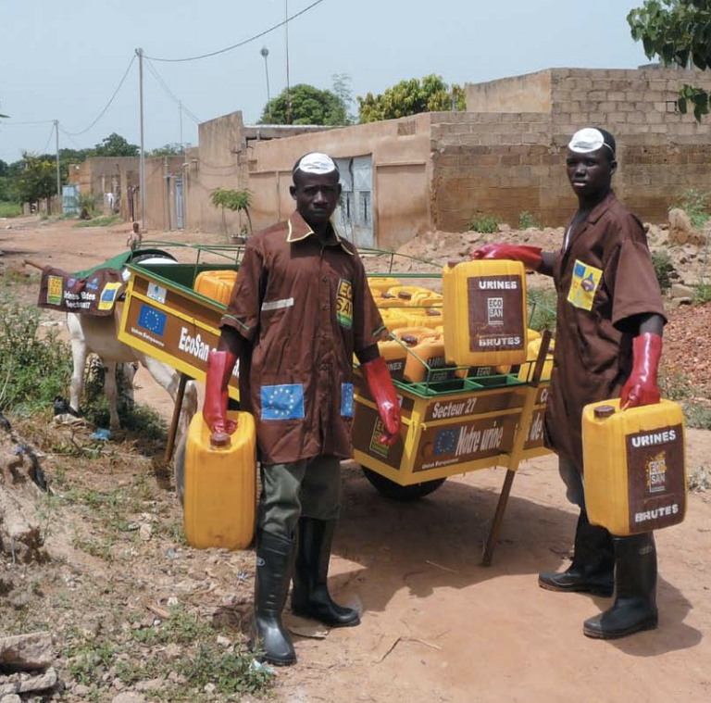
Sanitation and Hygiene
Table S. Rural sanitation and hygiene initiative annual monetary cost
Name | Value (US$) | Source | Country
Capital expenses (first few years only) | 20,000,000 | WSP, 2011 | Burkina Faso
Operational expenses | 2,000,000 | WSP, 2011 | Burkina Faso
Maintenance and Repair | 5,000,000 | WSP, 2011 | Burkina Faso
Assumptions:
Latrines and hygiene stations will be accepted and used by all households receiving the new facilities
Proper disposal and treatment of human feces will occur following defecation in the latrines
Only sanitation cost in rural location was used for this estimate, as 70% of Burkina Faso lives rurally.
WSP, 2011

Slide 18
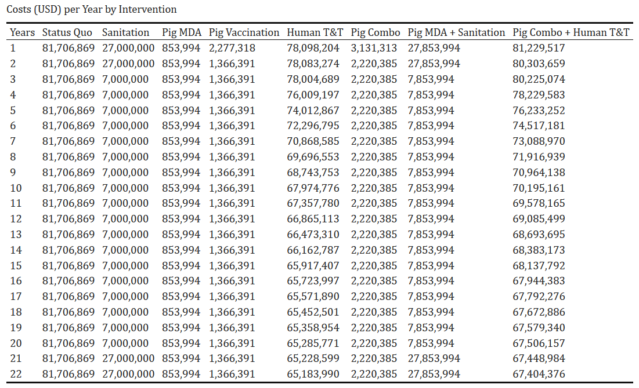

Slide 19
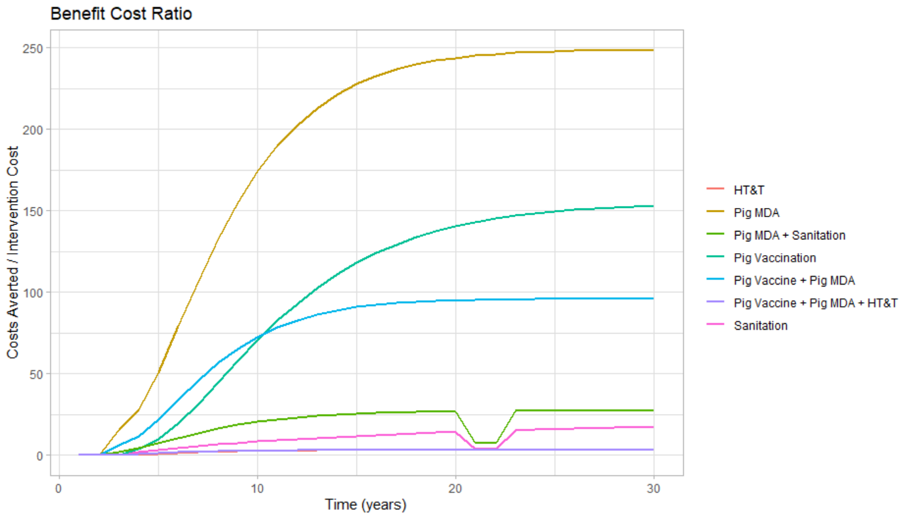

Slide 20
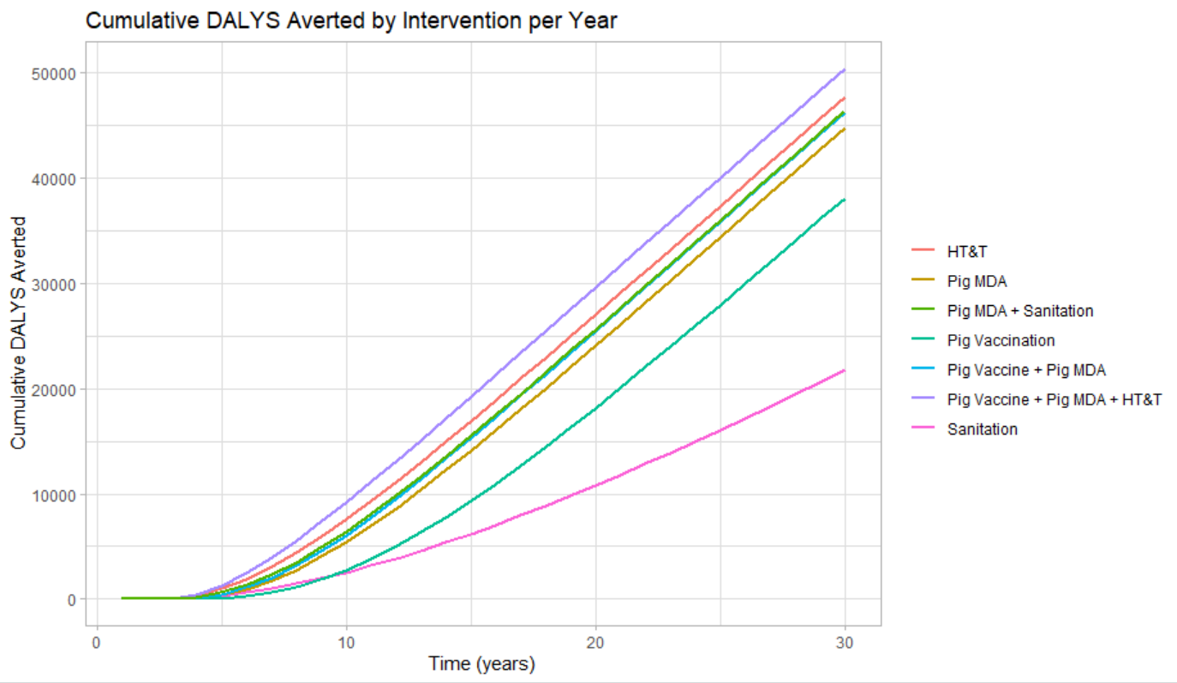

Slide 21
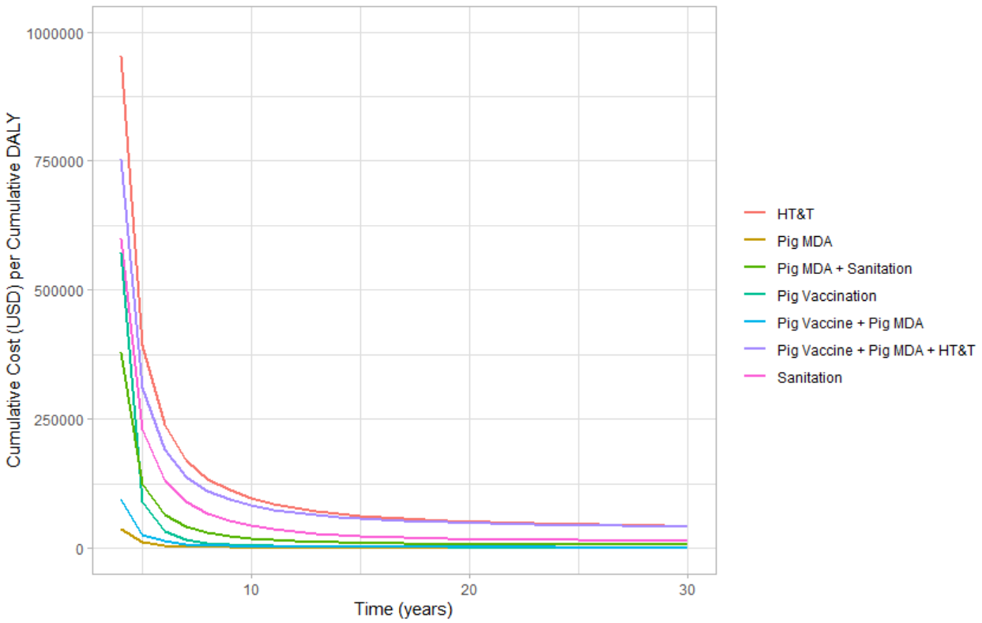

Slide 22
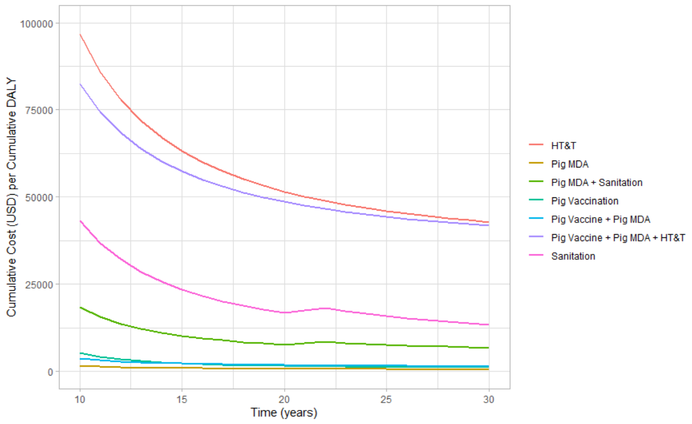

Slide 23
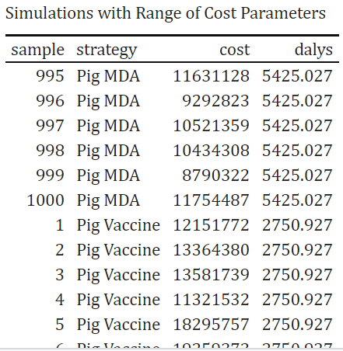
Probabilistic Sensitivity Analysis
Parameters we modified
Pig Vaccines, Pig MDA: varied indirect costs (personnel, transportation)
Sanitation: varied capital expenditures
HT&T: varied testing coverage

Slide 24
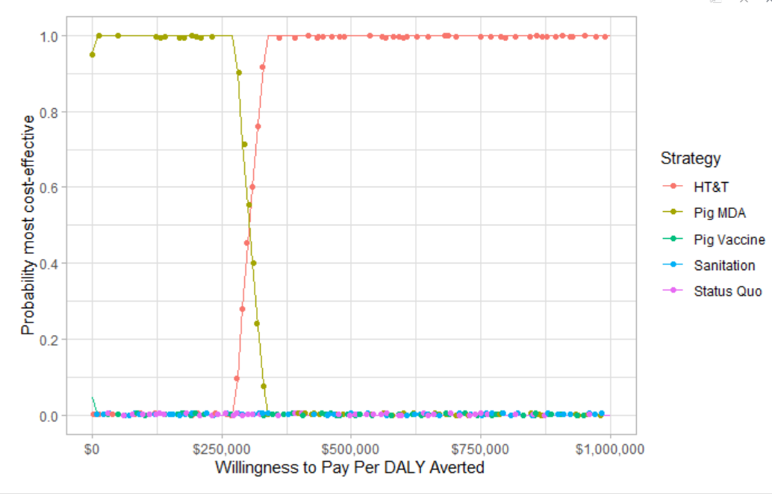
Decision Analysis

Slide 25
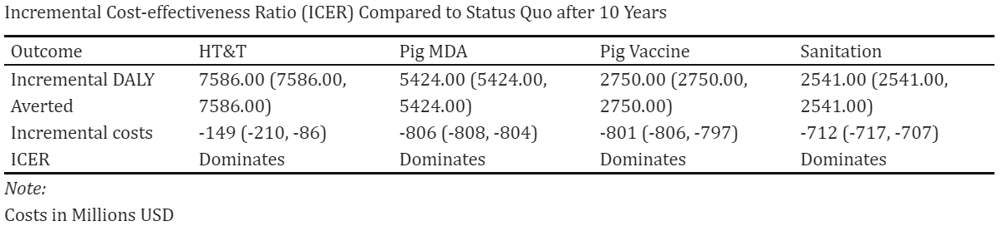
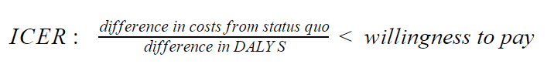

Slide 26
Limitations
MANY Assumptions
EpiCyst model assumptions:
homogenous population
no population growth
All those already mentioned
Parameter Estimates: limited literature, attempted to only collect data from West Africa
No thorough sensitivity analysis
We are not experts in the field

Slide 27
Conclusion
All interventions are cost-effective.
All interventions reduce DALYs.
Any would be better than Status Quo.
When thinking of impact:
We recommend a combination of interventions that is sustainable and addresses the root of the problem:
SANITATION with Pig MDA

Slide 28
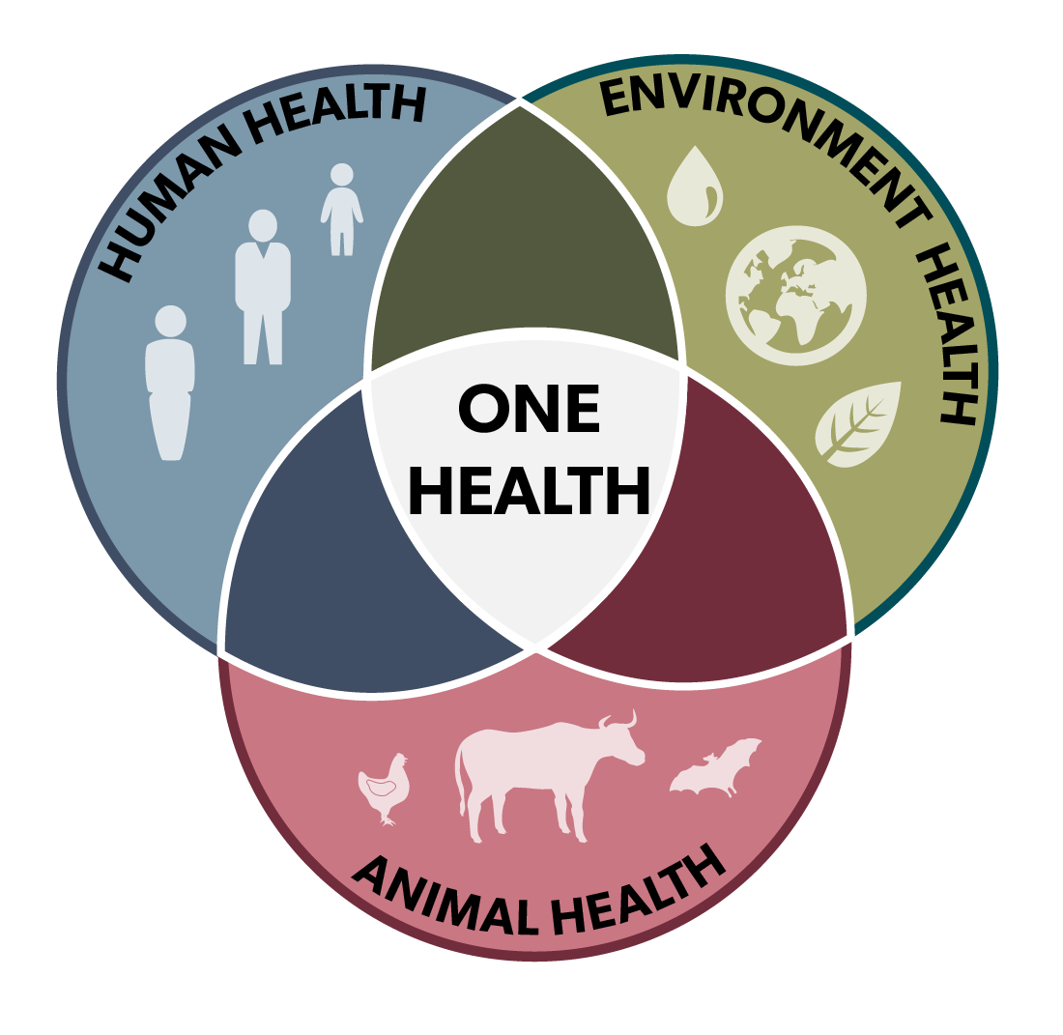
Thank you for your attention.

